Slide 1
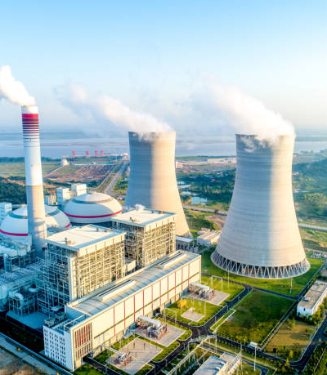
Meta System Modelling:
Thermal Power Plant
Presenter Name : Sowrish Karthick S
Reg No : 22BEI0088
Faculty Guide : Dr. Mahalakshmi P
Department / Course code: BEEE497J Project – I

Slide 2
Agenda
Introduction
Timeline
Problem statement
Scope
Methodology
Presentation Title

Slide 3
Introduction
The Meta-System Modeling and Simulation Framework instantiates a coal-fired generation asset as a canonical complex system, capturing fuel handling, thermal conversion, cooling, and water-treatment loops alongside stochastic outages drawn from `src/simulation_core.py`.
By generalising nuclear/thermal power plant dynamic modelling into a decision-support context, the platform couples first-order process physics, Monte Carlo reliability, and economic scoring so panel reviewers can evaluate operational trade-offs with real data artifacts.

Slide 4
Problem Statement and Objectives
Simulates fuel–steam–turbine–condenser–water dynamics with configurable parameters.
Models stochastic reliability (MTBF/MTTR) to derive composite uptime and performance indices.
Computes revenue, cost, and profit metrics for economic scenario analysis.
Ensures reproducible runs through structured data exports and interactive Plotly dashboards for KPI and subsystem insights.

Slide 5
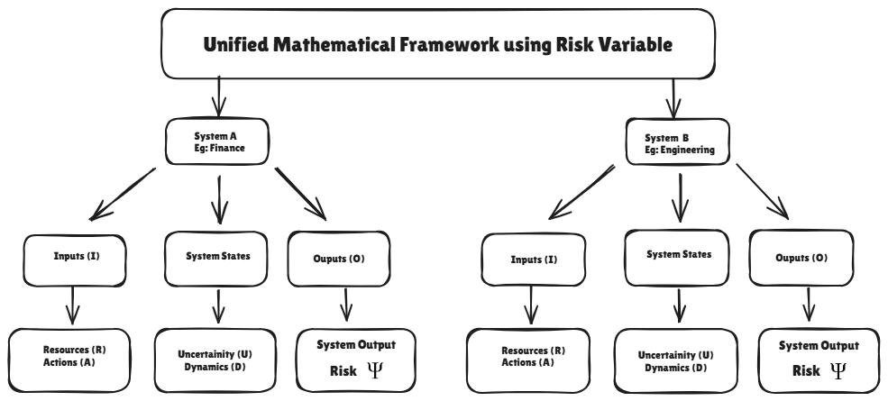
Methodology

Slide 6

Progress So Far
Simulation Engine: Runs a system lifecycle combining dynamic demand patterns, reliability constraints, and Monte Carlo uncertainty to produce plant-level KPIs.
Reliability & Economics: Quantifies uptime, performance degradation, energy generation, cost breakdowns, carbon penalties, and profitability metrics.
Infrastructure & Visualization: Automated data storage, computation reuse, and visualization through stacked cost/revenue plots, subsystem dashboards, and executive summaries.

Slide 7
Results and Discussion
Simulated 10,950 days (30 years) with total export of 120.55 TWh at 83.4% capacity factor, consuming 49.67 Mt of coal.
Generated 8.78 B in revenue vs 11.29 B in costs, resulting in –2.51 B net profit (–28.6% margin) under present carbon and O&M assumptions.
Achieved 95.46% uptime, 11,942 h downtime, MTBF = 73.1 h, MTTR = 3.5 h, and 97.0% reliability index across 3,432 outages.
Monte Carlo results confirm stable availability (uptime 95.36 ± 0.10%) and downtime (12,195 ± 272 h); dashboard visualizes KPIs, costs, reliability gauges, and 12-subsystem trends for quick insights.

Slide 8
Work Pending
Upgrade data persistence to Parquet or database formats for scalable analytics and future model training.
Refine subsystem-level reliability modeling and propagate partial performance effects through Monte Carlo runs.
Next phase: validate the framework and train ML models on generated data for faster simulation and forward performance projection.

Slide 9
Conclusion
The framework unifies process dynamics, stochastic reliability, economics, and visualization into a reusable template for meta-system decision analysis.
With long-horizon simulations completed and visualized, it is now positioned for scenario exploration, validation, and integration of ML-driven control and sustainability extensions.

Slide 10
References
Hansson, N., & Persson, S. Stochastic Optimization of Asset Management Project Portfolios: A Risk-Informed Approach.
NumPy Developers. NumPy: Numerical array computation and integration framework used throughout simulation modules.
pandas Development Team. pandas: Tabular data management library for results archiving and dashboard ingestion.
Plotly Technologies Inc. Plotly Graph Objects: Visualization library for KPI and subsystem analytics.
Plotly Technologies Inc. Dash: Interactive dashboard framework for visualization and control interfaces.

Slide 11




Thank you
Sowrish Karthick S
22BEI0088

